Slide 1

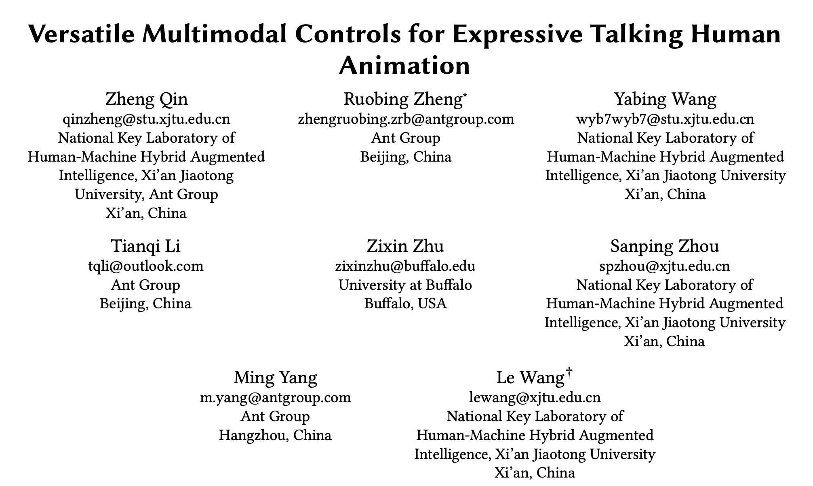
Notes:
Hi everyone, I'm ZhengQin, a PhD student from Xi'An Jia Tong University. In this video, we will introduce our work, versatile multimodal controls for expressive talking human animation, which is a collaborative project with the digital human team at ant group.

Slide 2
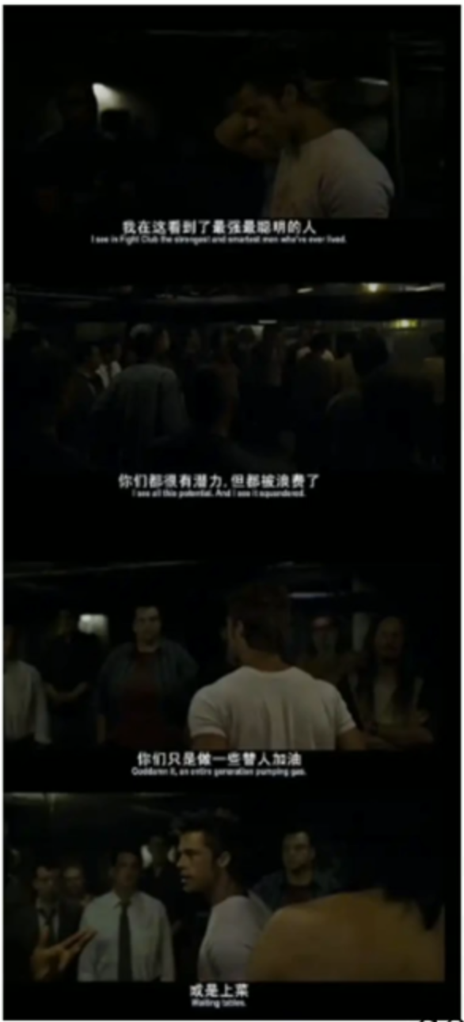
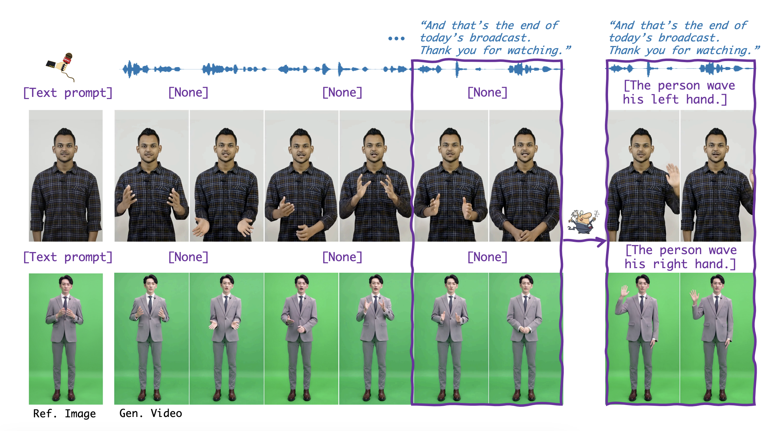
Motivation
Notes:
In film making, directors typically allow actors to perform freely based on the script before providing specific guidance on how to present key actions. AI generated content faces similar requirements where users not only need automatic generation of lip synchronization and basic gestures from audio input, but also desire semantics, accurate and expressive body movement That can be directly guided through descriptions. Given a reference image in the first column and an audio clip, our method generates photorealistic talking videos. Our approach supports arbitrary reference images, semibody in the upper demo and whole body in the lower, and allows users to control or edit the body motion by text prompts like waving different hand, at the closing in the conversation.

Slide 3
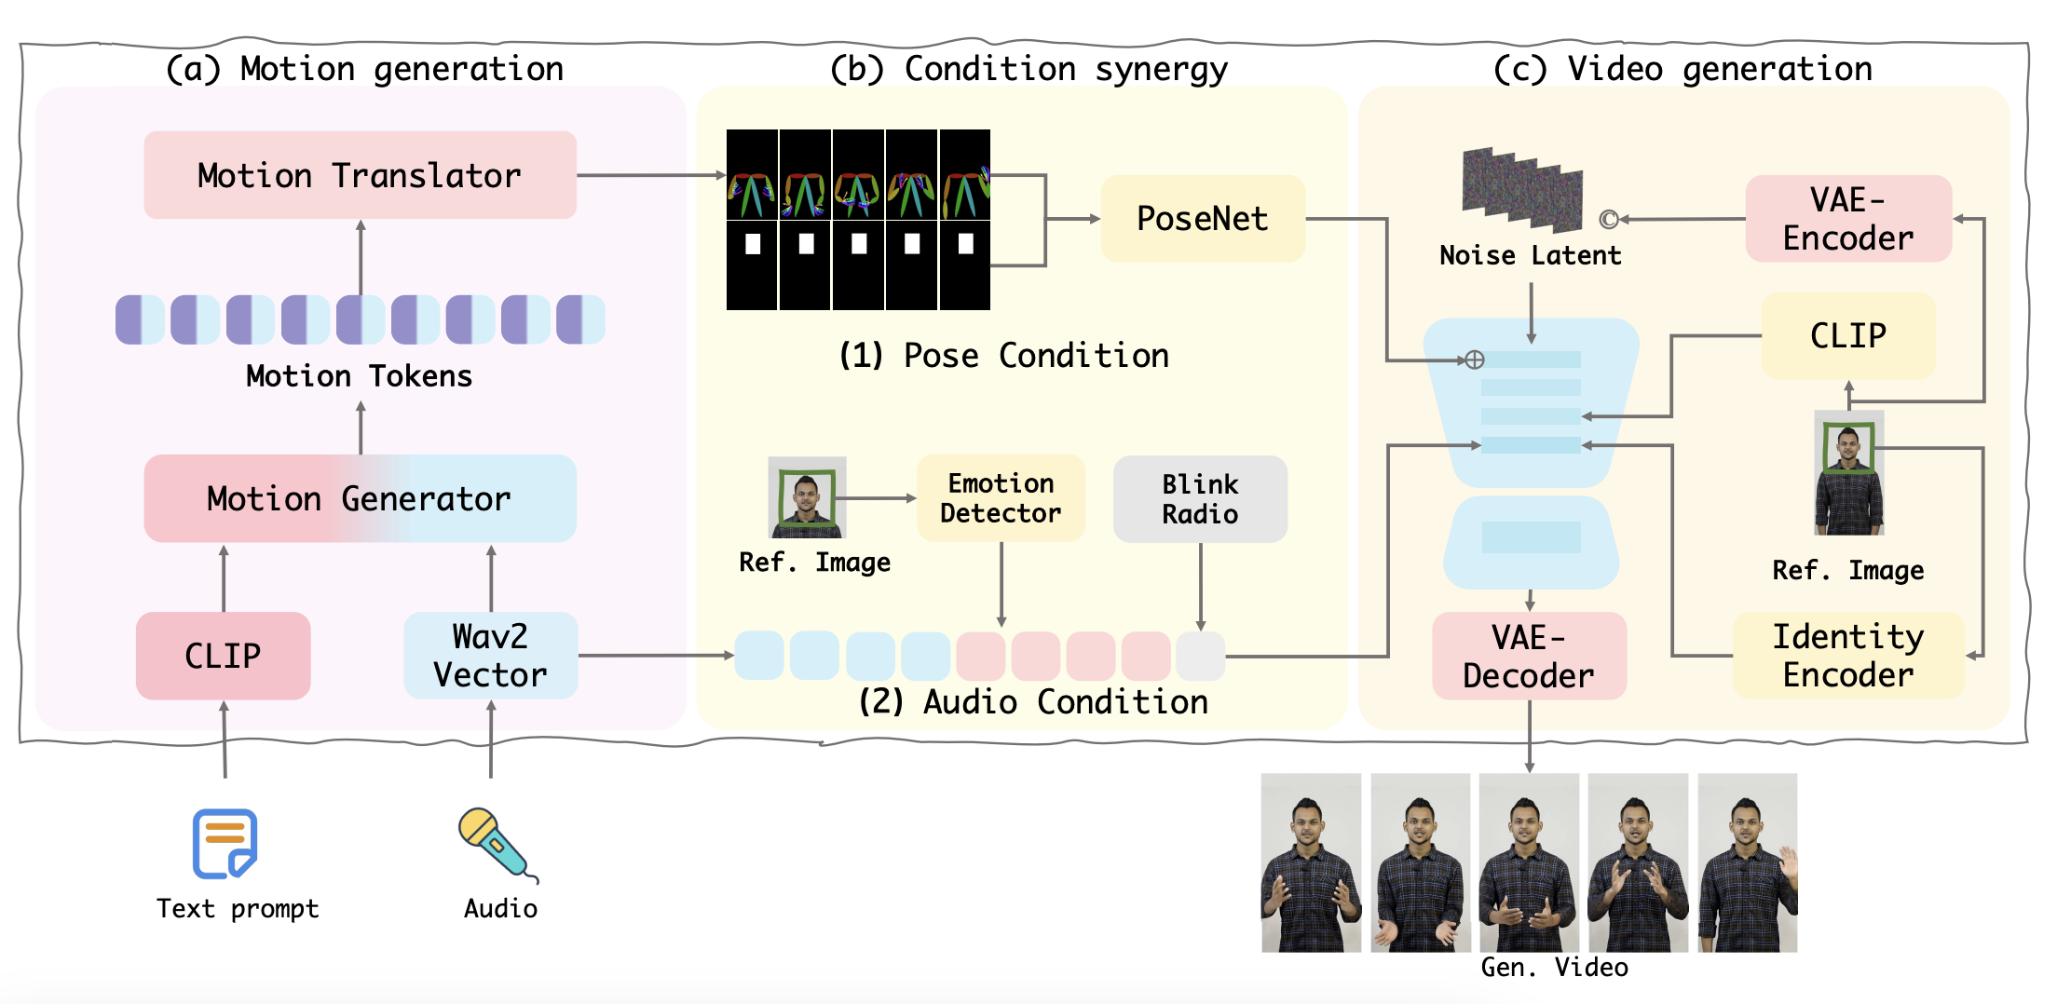
Overview of VersaAnimator
Notes:
Therefore we present Versa animator, a versatile framework that synthesizes expressive talking human videos from arbitrary portrait images. As shown in the screen. The Motion Generation process uses both audio and text modalities to specify the facial and body motion. Condition Synergy process generates the pose condition and audio condition as the control signal in video generation. Finally, we inject both conditions into the diffusion model to animate the reference character for Video Generation.

Slide 4
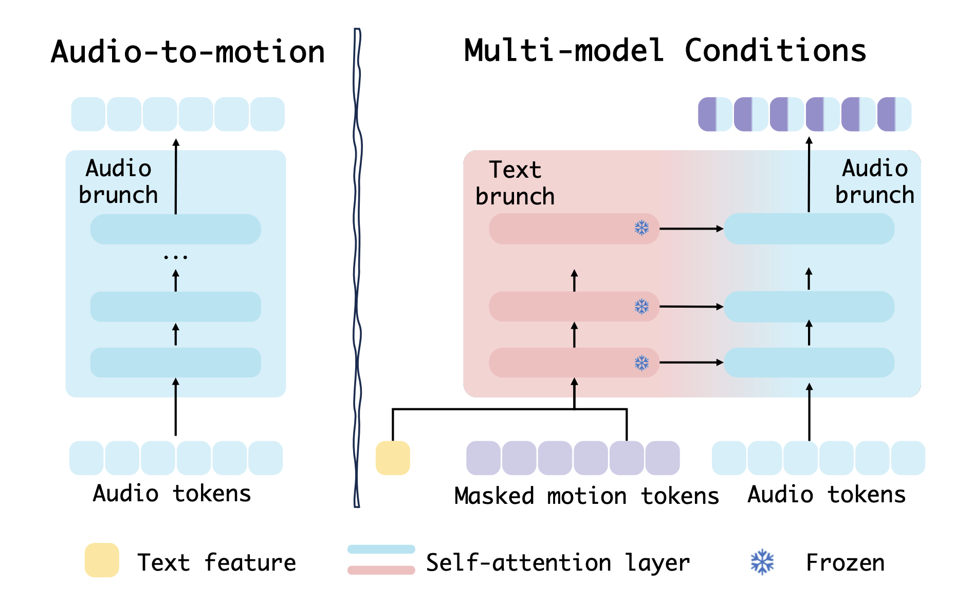
Details Structure of Motion Generator
The two-branch transformer that generates motions conditioned on both audio and text prompts.
The primary audio-to-motion architecture.
Notes:
As shown in the screen, We implement that as the primary audio to motion Architecture. Specifically, the audio tokens are fed into the transformer encoder to capture long range dependencies and contextual relationships within the audio sequence. To allow the text to control the prediction of the motion token, we adopted a two branch transformer. Specifically, we Learned a text to motion transformer to model the tokens conditioned on text. The text to motion transformer has the same architecture as the primary audio to motion model.

Slide 5
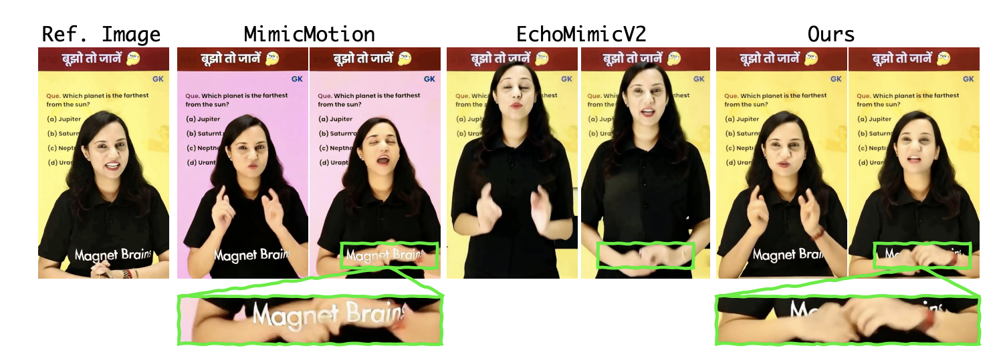
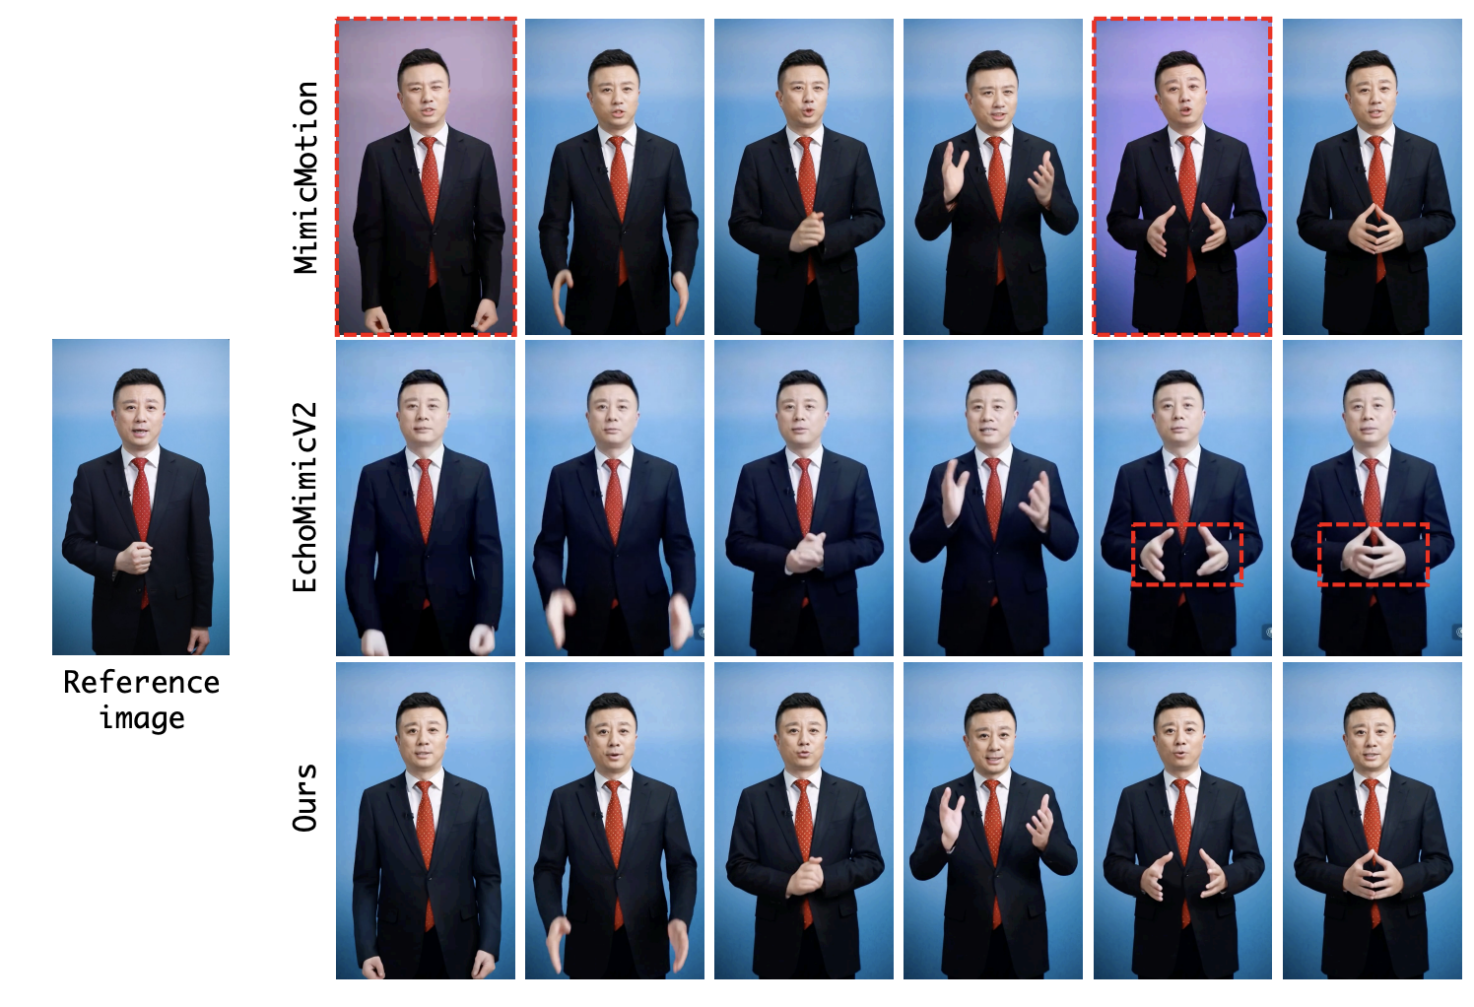
Performance
Notes:
Left side shows that our method preserves fine details from the reference image such as clothing patterns, background, and character position. Right side shows that versa animator achieves better clarity in local areas such as the hands.

Slide 6
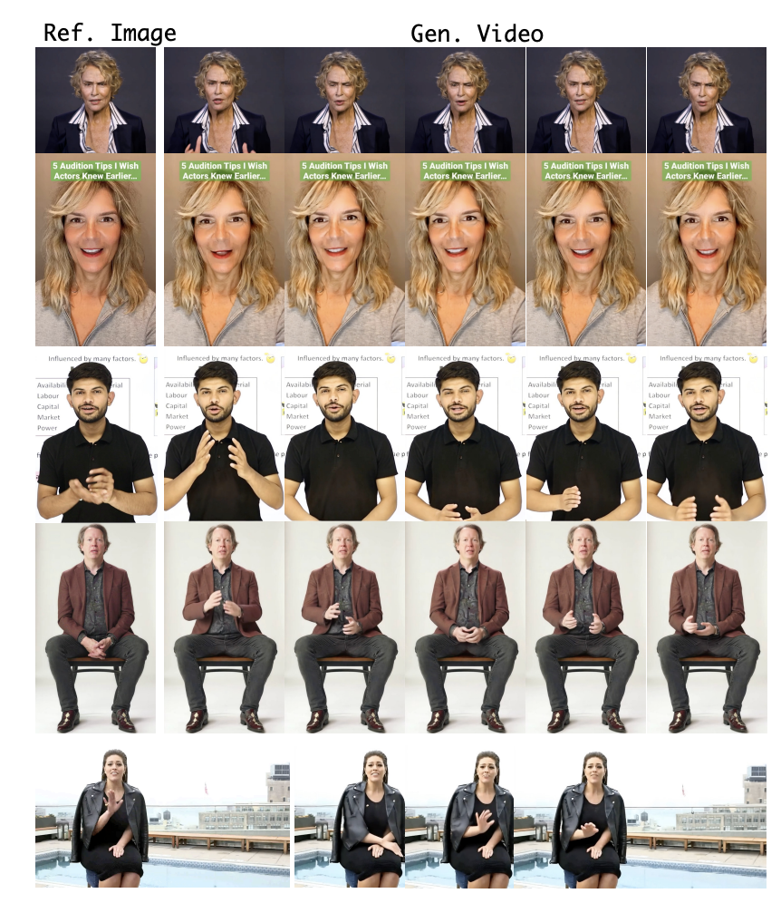
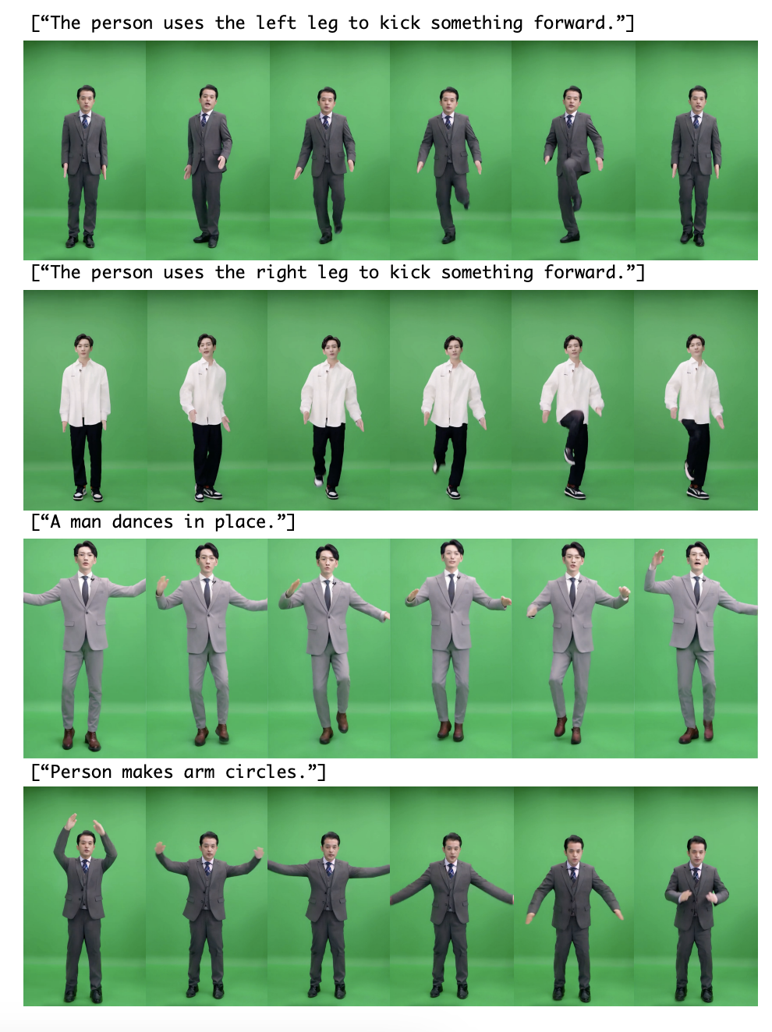
Notes:
The left side shows results on multi-animat with different audio and reference images ranging from head to whole body.
The right side presents a visual illustration of text control for customizing the character's motion in the generated video. Thank you for listening.

Slide 7
Thank you!
If you are interested in my research or potential collaboration, feel free to reach out.
🔍 Research Interests:
Audio-driven Human Animation
Multi-object Tracking
Multimodal Large Language Models
📧 Email: qinzheng@stu.xjtu.edu.cn

